Slide 1

ASSIGNMENT 8
Diversity Techniques Analysis:
SC, EGC, and MRC

Slide 2


Problem Statement
Wireless channels suffer from multipath fading, where signal strength fluctuates randomly, leading to high Bit Error Rates (BER).
The Solution?
Diversity techniques use multiple antennas to improve reliability. This study analyzes how different combining methods mitigate fading effects in a SIMO (Single-Input Multiple-Output) system.
Signal Fading
Deep fades cause data loss

Slide 3





Objectives
Implement SC
Implement EGC
Implement MRC
Selection Combining: Choosing the strongest signal path.
Equal Gain Combining: Phase alignment and equal weighting.
Maximal Ratio Combining: Optimal weighting based on SNR.

Slide 4



System Architecture Overview
Simulation Parameters
•
Modulation: BPSK (Binary Phase Shift Keying)
Rx 1
•
Channel: Rayleigh Fading (Complex Gaussian)
Tx (1)
•
Configuration: SIMO (1 Tx, 2 Rx antennas)
•
Rx 2
Noise: AWGN (Additive White Gaussian Noise)
•
Samples: 10^5 bits for statistical accuracy
1x2 Diversity System

Slide 5
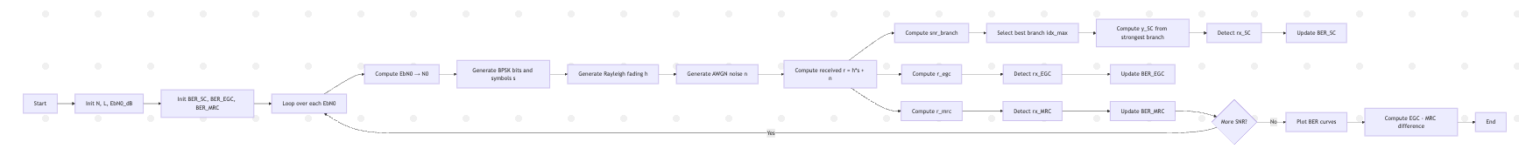





Data Flow Diagram (DFD)
(Random Gen)
(BPSK)
(Rayleigh + AWGN)
(SC / EGC / MRC)

Slide 6
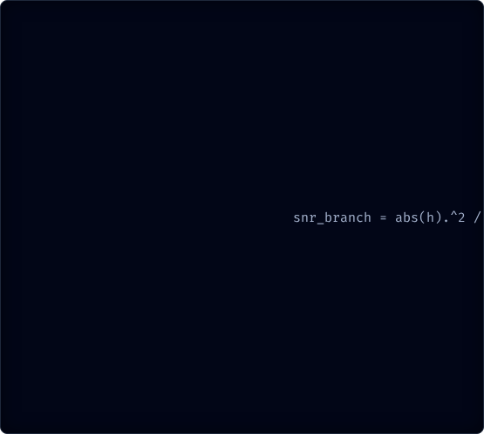
Pseudocode: Selection Combining (SC)
START
Set number of bits N
Set number of diversity branches L = 2
Define SNR range EbN0_dB
Initialize BER arrays:
BER_SC
BER_EGC
BER_MRC
FOR each SNR value in EbN0_dB:
Convert SNR from dB → linear (EbN0)
Compute noise variance N0 = 1 / EbN0
Generate random BPSK bits tx
Map to symbols s = 2*tx – 1
Generate Rayleigh fading matrix h of size L × N
Generate AWGN noise n of size L × N
Compute received signals r = h*s + n
--------------------------------------------------------
SELECTION COMBINING (SC)
--------------------------------------------------------
Compute branch SNRs snr_branch = abs(h)^2 / N0
For each bit find best branch index idx_max
For each k:
y_SC(k) = conj(h_selected) * r_selected / abs(h_selected)
Detect rx_SC = sign(real(y_SC))
Compute BER_SC
Explanation
•
Logic: Monitor the SNR of all diversity branches.
•
Selection: At any instant, the receiver processes only the signal from the antenna with the highest instantaneous SNR.
% 3. Select signal from that branch
FOR
% Co-phase and normalize
END
% 4. Detection
•
Pros/Cons: Simplest to implement but discards useful energy from other branches.

Slide 7

Pseudocode: Equal Gain Combining (EGC)
--------------------------------------------------------
EQUAL GAIN COMBINING (EGC)
--------------------------------------------------------
Phase-align signals: r_egc = sum( r * exp(-j*angle(h)) )
Detect rx_EGC = sign(real(r_egc))
Compute BER_EGC
Explanation
•
Logic: Utilize signals from all branches.
•
Phase Alignment: The phase shift introduced by the channel is removed (co-phasing) so signals add constructively.
% 2. Summation
% Sum all aligned branches equally
% 3. Detection
% 4. Error Calculation
•
Weighting: All branches are given equal weight (unlike MRC).

Slide 8

Pseudocode: Maximal Ratio Combining (MRC)
Explanation
•
Logic: Optimal linear combining technique.
--------------------------------------------------------
MAXIMAL RATIO COMBINING (MRC)
--------------------------------------------------------
Compute weighted sum r_mrc = sum( conj(h) * (h*s + n) )
Detect rx_MRC = sign(real(r_mrc))
Compute BER_MRC
END FOR
Plot all BER curves (SC, EGC, MRC)
Compute difference between EGC and MRC
END
•
Weighting: Branches are weighted proportional to their signal amplitude. Strong signals contribute more; weak/noisy signals contribute less.
•
Result: Maximizes the output SNR.
% AND removes phase shift simultaneously
% 3. Detection
% 4. Error Calculation

Slide 9
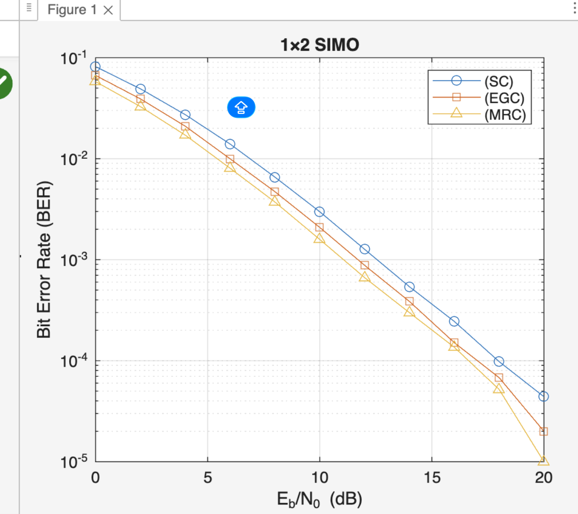
Results: BER Comparison
Performance Hierarchy
•
MRC (Best): Lowest BER curve. Maximizes SNR.
•
EGC (Middle): Very close performance to MRC (~1.4e-3 diff).
•
SC (Worst): Requires higher SNR to achieve same BER.

Slide 10


Results: Data Analysis
EGC vs MRC Comparison
For equal noise variance branches, EGC and MRC perform very similarly.
Why is MRC better?
MRC penalizes noisy branches by assigning them smaller weights (|h|). EGC treats noise in weak branches the same as strong branches, slightly degrading performance.

Slide 11
Conclusion & Future Scope
Conclusion
•
Future Scope
Diversity techniques significantly lower BER in fading channels.
•
MIMO Systems: Extending diversity to both Transmit and Receive sides (Tx/Rx Diversity).
•
MRC is the optimal combiner but requires estimating channel amplitude and phase (High complexity).
•
Correlated Fading: Analyzing performance when antennas are close together (correlation > 0).
•
EGC offers a good trade-off, needing only phase estimation.
•
Real-time Implementation: Testing on FPGA or SDR (Software Defined Radio).
•
SC is simplest but least efficient.

